Slide 1

CE101 Engineering Drawing Lec3: Orthographic Projections
Indian Institute of Technology Guwahati
Notes:
Today we will discuss about the Modeling and

Slide 2
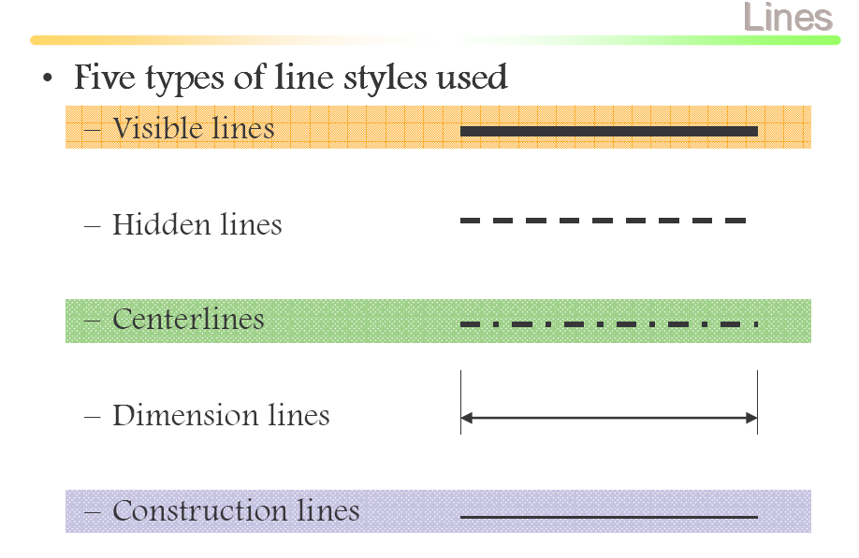

Slide 3
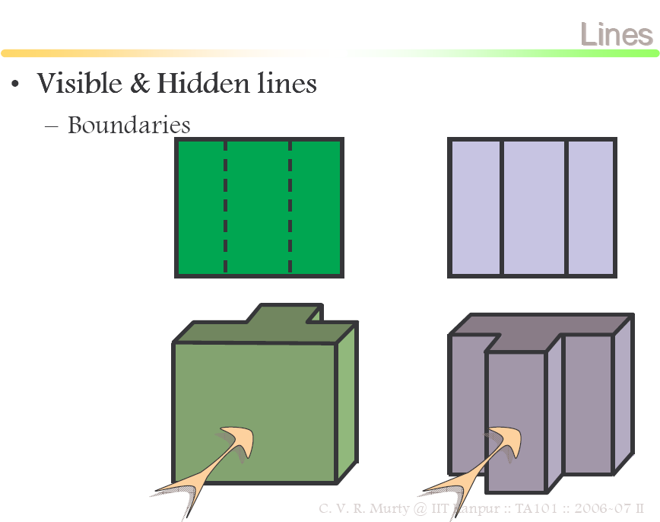

Slide 4
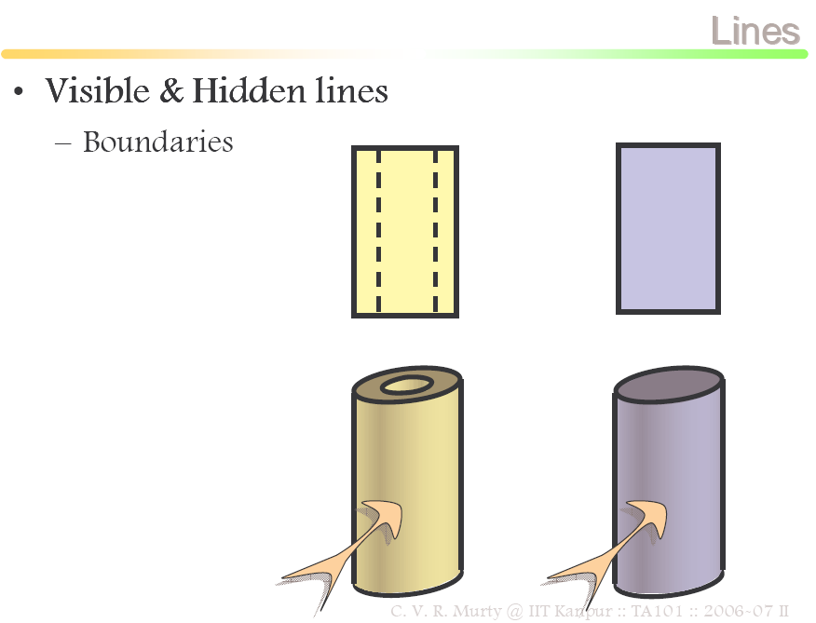

Slide 5
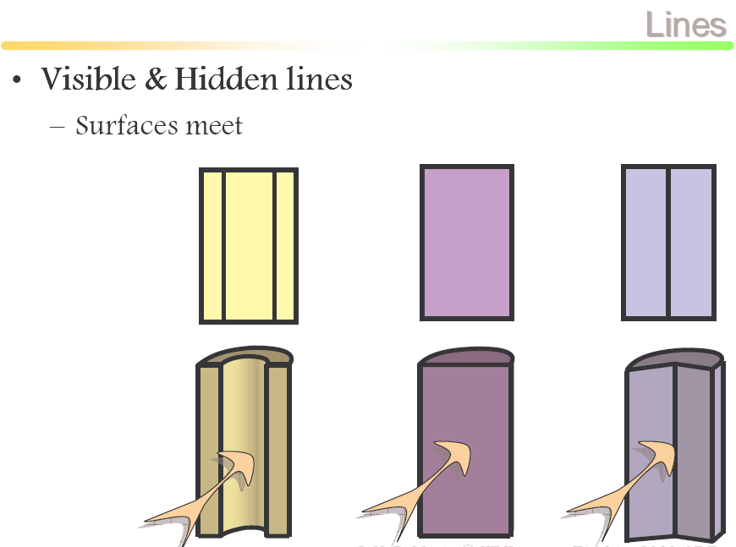

Slide 6
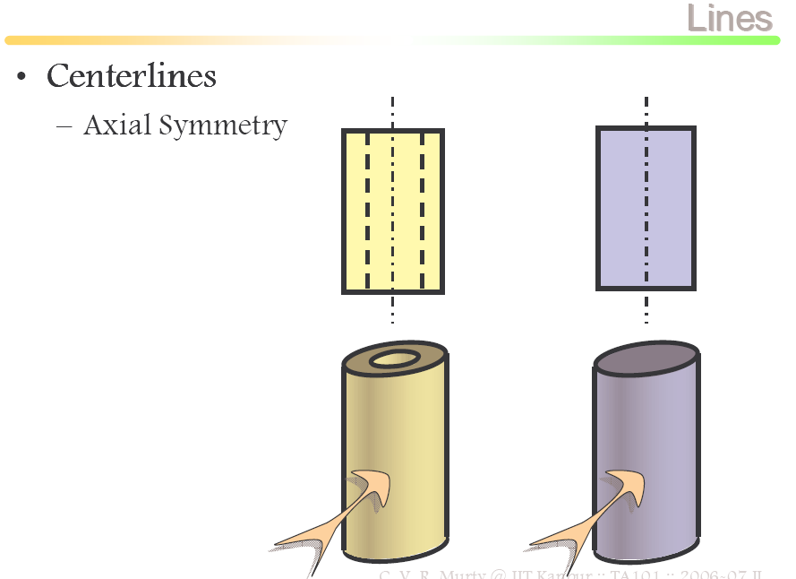

Slide 7
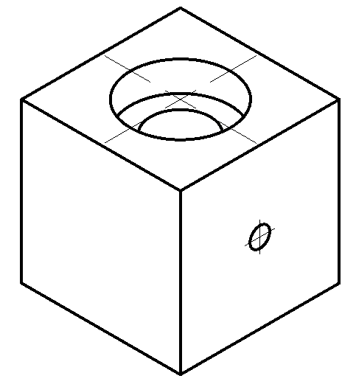
Example
1. Visible
2. Hidden
3. Center

Slide 8
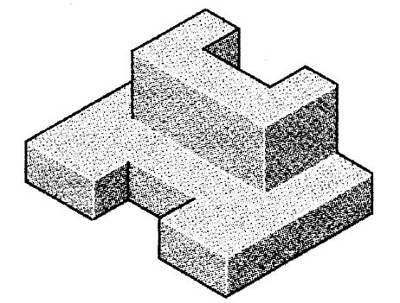
Construction Lines
Construction lines are used to transfer depth information.
45º line drawn from point O
O
Standard multiviews

Slide 9
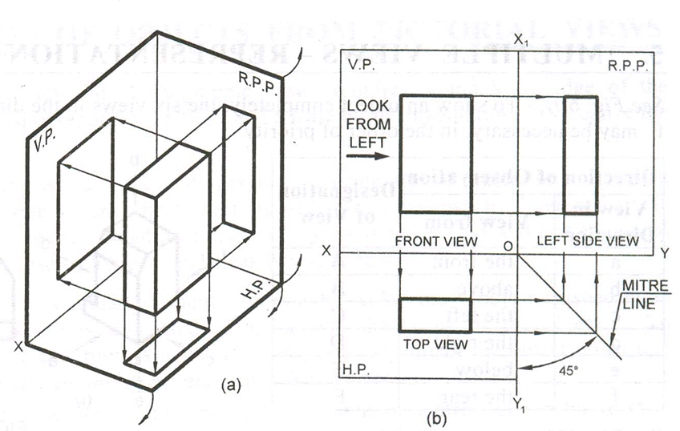
Projecting Side Views
Projecting across meter line
Projecting through arcs
Projecting through 45º projectors

Slide 10
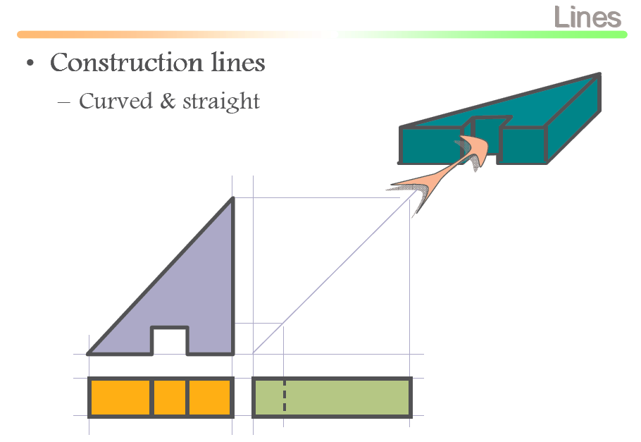
TV
FV
LSV

Slide 11
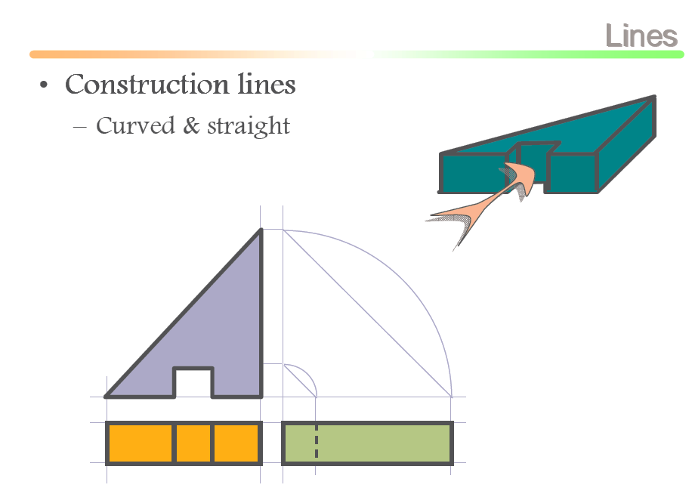

Slide 12
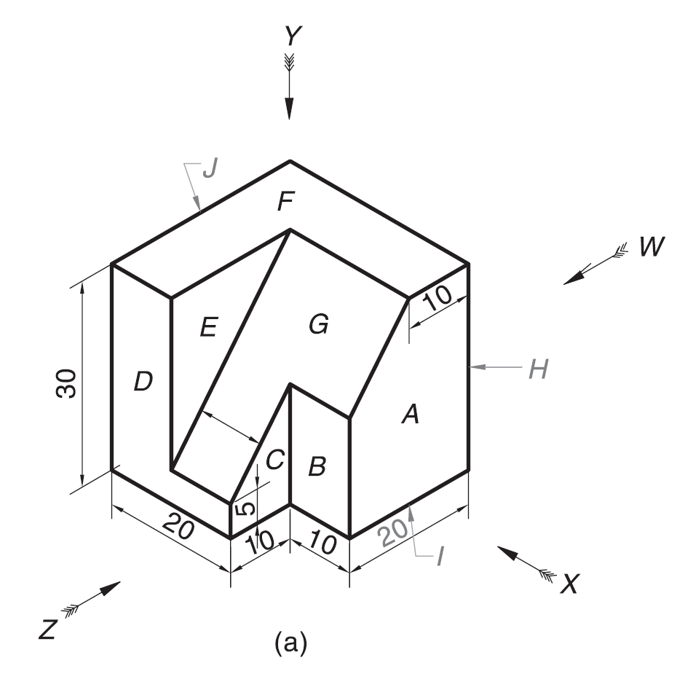
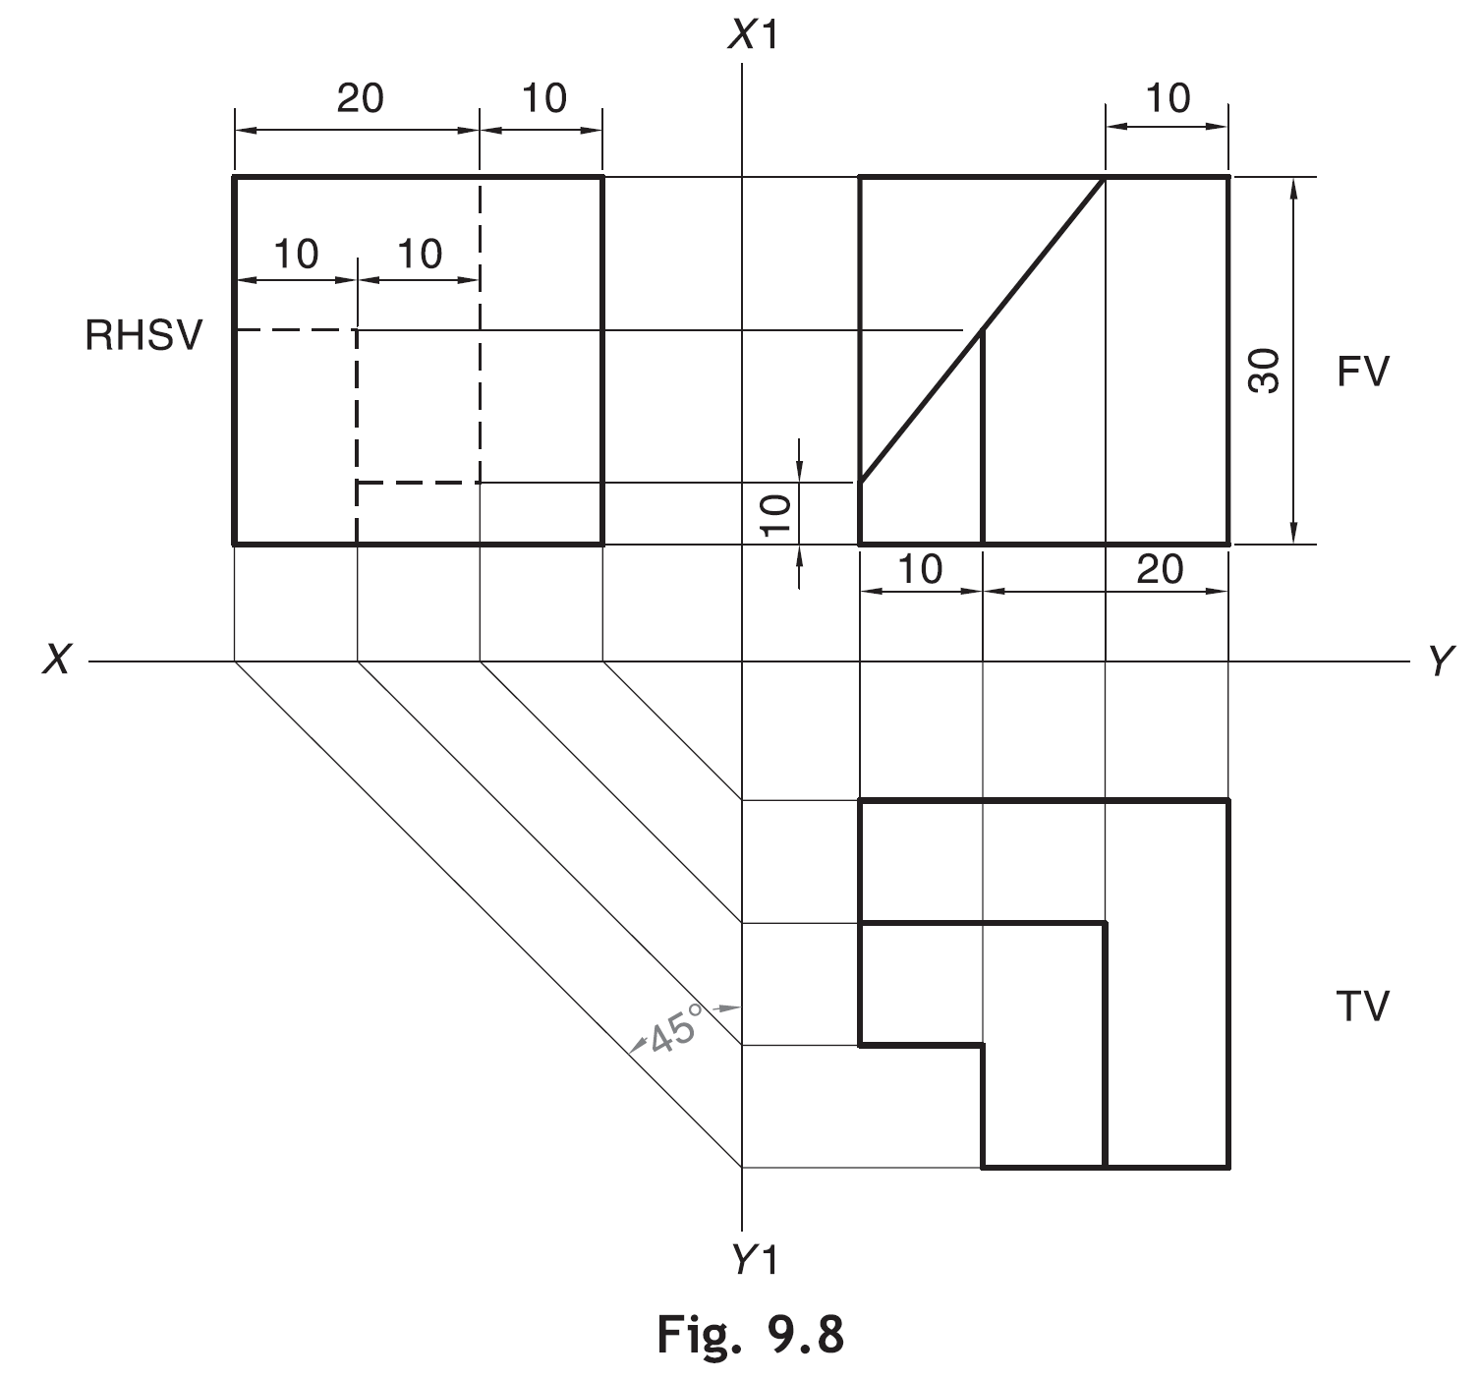

Slide 13
View selection procedures
1. Orient the object to the best position relative to a glass box.
2. Select the front view.
3. Select adjacent views.

Slide 14
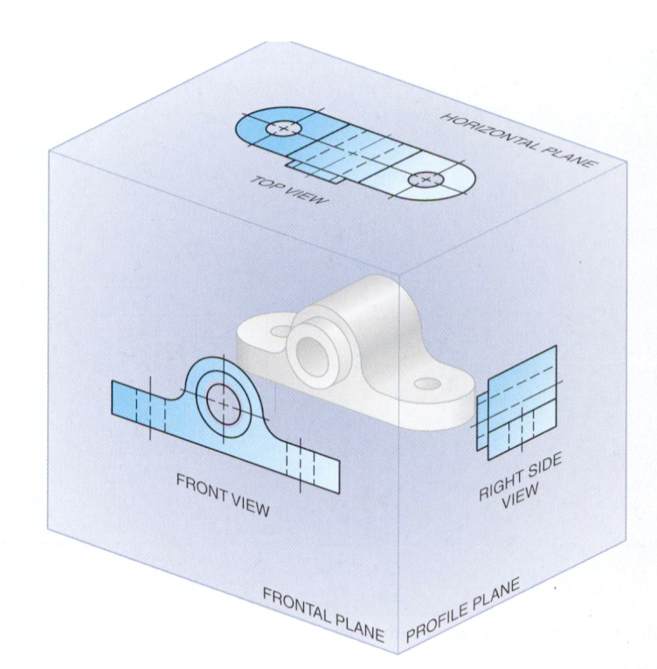
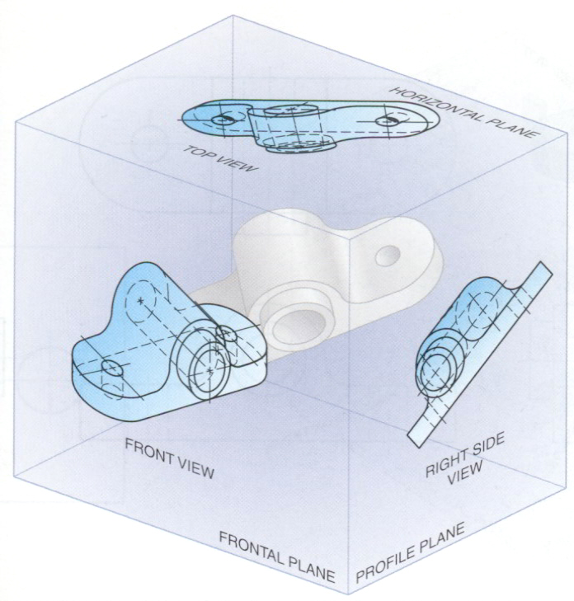
Suggestions: Orient the object
1. The object should be placed in its natural position.
2. The orthographic views should represent the true size and true shape of an object (as much as possible).
GOOD
NO !

Slide 15
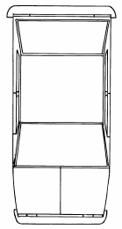
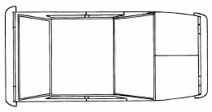
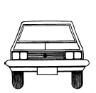
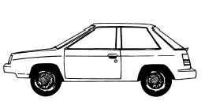
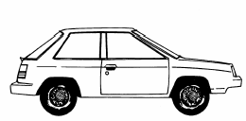

Suggestions: Select the front view
1. The longest dimension of an object should be presented as a width (in a front view).
First choice
Inappropriate
Second choice
Good
Use more space
Notes:
Imp slide

Slide 16
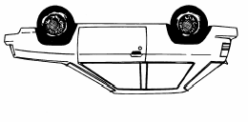
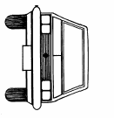
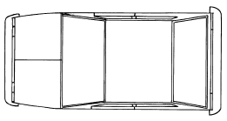
Suggestions: Select the front view
2. The adjacent views project from the selected front view should be appeared in a natural position.
Inappropriate

Slide 17

Suggestions: Select the front view
3. It has the fewest number of hidden lines.
Good
Inappropriate

Slide 18
Suggestions: Select an adjacent view
1. Choose the view that has the fewest number of hidden lines.
Inappropriate
Inappropriate

Slide 19
Suggestions: Select an adjacent view
2. Choose the minimum number of views that can represent the major features of the object.
All information is placed
on a single view.
Necessary
Hole’s information is placed on a separated view.
Necessary

Slide 20
Suggestions: Select an adjacent view
3. Choose the views that are suitable to a drawing sheet.
Poor
Not enough space
for dimensioning.
Choose another adjacent view.
Good
Change orientation of the
selected views.
Good

Slide 21
Summary
View selection has 3 steps
Orient
the object
Select
front view
Select
adjacent views

Slide 22
Object that requires only one-view
Flat (thin) part having a uniform thickness such as a gasket, sheet metal etc.
Cylindrical-shaped part.
Example
1 Thick
Adjacent views provide only a
part’s thickness !

Slide 23
Object that requires only one-view
Flat (thin) part having a uniform thickness such as a gasket, sheet metal etc.
Cylindrical-shaped part.
Example
Example
Repeat !
Infer from CL

Slide 24
Object that requires only two-view
Identical adjacent view exists.
The 3rd view has no significant contours of the object.
(provides no additional information)
Example
Repeat !

Slide 25
Object that requires only two-view
Identical view exists.
The 3rd view has no significant contours of the object.
(provides no additional information)
Example 1

Slide 26
Object that requires only two-view
Identical view exists.
The 3rd view has no significant contours of the object.
(provides no additional information)
Example 2

Slide 27
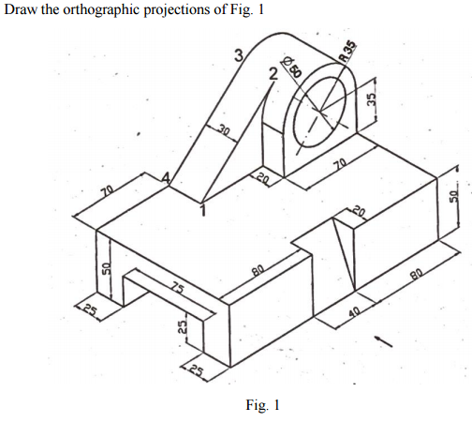
Example-1
Steps to draw projections
Identify surfaces perpendicular or inclined to the view
Surfaces parallel to the view would not be visible in that view.
First draw horizontal and vertical reference planes (easily identifiable on drawing)
Start drawing from the reference planes.

Slide 28
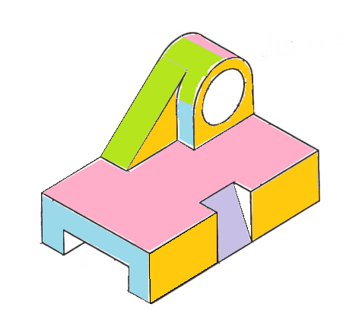
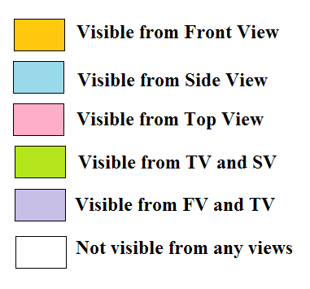
Vertical reference plane (VP)
Top view
Frontal reference plane (VP)
Horizontal reference plane (HP)
Side view
Front view

Slide 29
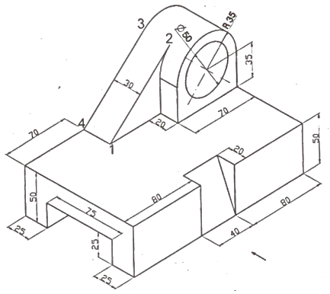
Midpoint
35
Φ 50
70
50
HP
80+40+80=200
Front view
Side view
70
30+20=50
20
80
40
VP
Top view

Slide 30
+
70
Φ 50
50
25
200
25
125
Front view
Side view
70
50
20
40
80
20
80
Top view

Slide 31
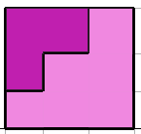
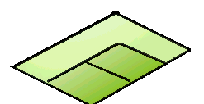

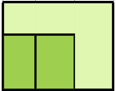



FOR T.V.
S.V.
F.V.
Example-2
ORTHOGRAPHIC PROJECTIONS
FRONT VIEW
L.H.SIDE VIEW
FOR F.V.
FOR S.V.
x
y
PICTORIAL PRESENTATION IS GIVEN
DRAW THREE VIEWS OF THIS OBJECT
BY FIRST ANGLE PROJECTION METHOD
TOP VIEW

Slide 32
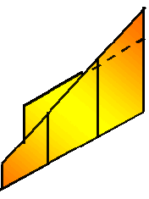

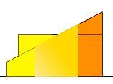

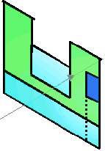


FOR T.V.
Example-3
S.V.
F.V.
ORTHOGRAPHIC PROJECTIONS
FRONT VIEW
L.H.SIDE VIEW
X
Y
FOR S.V.
FOR F.V.
TOP VIEW
PICTORIAL PRESENTATION IS GIVEN
DRAW THREE VIEWS OF THIS OBJECT
BY FIRST ANGLE PROJECTION METHOD

Slide 33






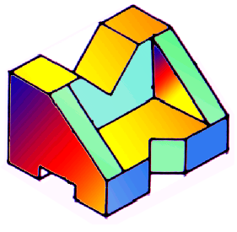
FOR T.V.
Example-4
F.V.
S.V.
ORTHOGRAPHIC PROJECTIONS
FRONT VIEW
L.H.SIDE VIEW
FOR S.V.
FOR F.V.
X
Y
PICTORIAL PRESENTATION IS GIVEN
DRAW THREE VIEWS OF THIS OBJECT
BY FIRST ANGLE PROJECTION METHOD
TOP VIEW

Slide 34
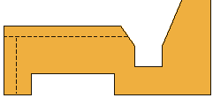
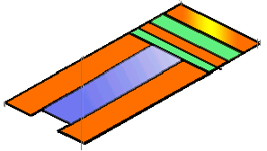

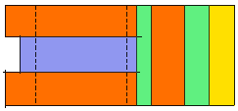
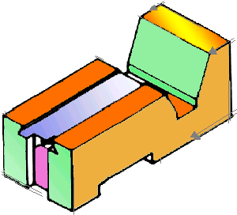
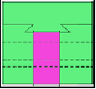
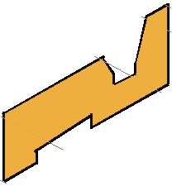
FOR T.V.
Example-5
S.V.
F.V.
ORTHOGRAPHIC PROJECTIONS
FRONT VIEW
L.H.SIDE VIEW
FOR F.V.
FOR S.V.
X
Y
PICTORIAL PRESENTATION IS GIVEN
DRAW THREE VIEWS OF THIS OBJECT
BY FIRST ANGLE PROJECTION METHOD
TOP VIEW

Slide 35
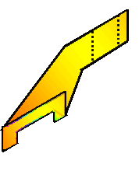
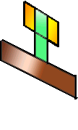
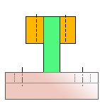
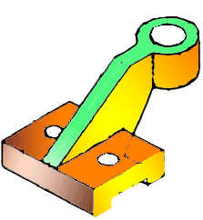
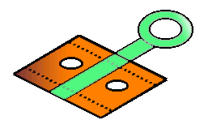
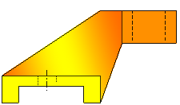
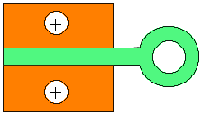
Example-6
FOR T.V.
F.V.
S.V.
ORTHOGRAPHIC PROJECTIONS
FRONT VIEW
L.H.SIDE VIEW
X
Y
FOR S.V.
FOR F.V.
TOP VIEW
PICTORIAL PRESENTATION IS GIVEN
DRAW THREE VIEWS OF THIS OBJECT
BY FIRST ANGLE PROJECTION METHOD

Slide 36
Example-7
FOR T.V.
ORTHOGRAPHIC PROJECTIONS
35
FV
35
x
10
y
10
20
30
FOR F.V.
40
70
TV
O
PICTORIAL PRESENTATION IS GIVEN
DRAW FV AND TV OF THIS OBJECT
BY FIRST ANGLE PROJECTION METHOD

Slide 37
Example-8
14
FOR T.V.
ORTHOGRAPHIC PROJECTIONS
FV
30
10
30
SV
30
10
30
x
y
FOR S.V.
FOR F.V.
TV
ALL VIEWS IDENTICAL
PICTORIAL PRESENTATION IS GIVEN
DRAW THREE VIEWS OF THIS OBJECT
BY FIRST ANGLE PROJECTION METHOD

Slide 38
Example-9
15
ORTHOGRAPHIC PROJECTIONS
FOR T.V.
ALL VIEWS IDENTICAL
FV
SV
x
y
10
40
60
FOR S.V.
FOR F.V.
40
TV
60
PICTORIAL PRESENTATION IS GIVEN
DRAW THREE VIEWS OF THIS OBJECT
BY FIRST ANGLE PROJECTION METHOD

Slide 39
FOR T.V.
Example-10
ORTHOGRAPHIC PROJECTIONS
ALL VIEWS IDENTICAL
FV
SV
x
y
10
FOR S.V.
FOR F.V.
40
60
PICTORIAL PRESENTATION IS GIVEN
DRAW THREE VIEWS OF THIS OBJECT
BY FIRST ANGLE PROJECTION METHOD
40
TOP VIEW
60

Slide 40
PICTORIAL PRESENTATION IS GIVEN
DRAW FV AND TV OF THIS OBJECT
BY FIRST ANGLE PROJECTION METHOD
ORTHOGRAPHIC PROJECTIONS
FOR T.V.
30
Example-11
FV
RECT.
SLOT
10
50
35
10
Y
X
20 D
FOR F.V.
TV
60 D
30 D
TOP VIEW
O

Slide 41
FOR T.V.
Example-12
ORTHOGRAPHIC PROJECTIONS
45⁰
30
FV
40
X
Y
φ30
FOR F.V.
40
TV
O
PICTORIAL PRESENTATION IS GIVEN
DRAW FV AND TV OF THIS OBJECT
BY FIRST ANGLE PROJECTION METHOD
15
40

Slide 42
Example-13
ORTHOGRAPHIC PROJECTIONS
10
10
15
25
25
X
Y
O
50
10
FV
LSV
FOR S.V.
FOR F.V.
PICTORIAL PRESENTATION IS GIVEN
DRAW FV AND LSV OF THIS OBJECT
BY FIRST ANGLE PROJECTION METHOD

Slide 43
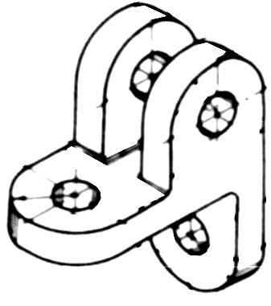
FOR T.V.
Example-14
ORTHOGRAPHIC PROJECTIONS
FRONT VIEW
L.H.SIDE VIEW
X
Y
FOR F.V.
FOR S.V.
TOP VIEW
PICTORIAL PRESENTATION IS GIVEN
DRAW THREE VIEWS OF THIS OBJECT
BY FIRST ANGLE PROJECTION METHOD

Slide 44
ORTHOGRAPHIC PROJECTIONS
FRONT VIEW
L.H.SIDE VIEW
30 SQUARE
40
20
50
FOR F.V.
20
FOR S.V.
X
10
Y
O
30
F.V.
60
S.V.
PICTORIAL PRESENTATION IS GIVEN
DRAW FV AND SV OF THIS OBJECT
BY FIRST ANGLE PROJECTION METHOD

Slide 45
FOR T.V.
ORTHOGRAPHIC PROJECTIONS
FV
40
X
10
Y
O
30 D
45
FOR F.V.
O
10
50
PICTORIAL PRESENTATION IS GIVEN
DRAW FV AND TV OF THIS OBJECT
BY FIRST ANGLE PROJECTION METHOD
80
TV

Slide 46
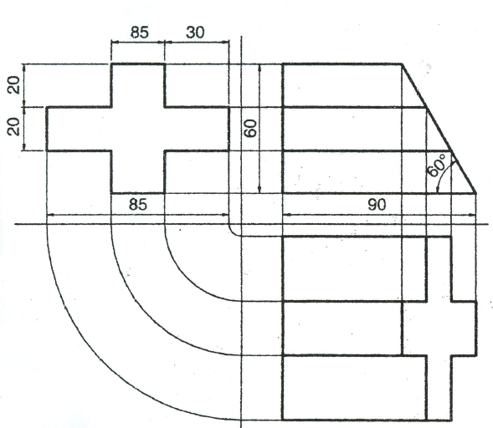

Slide 47
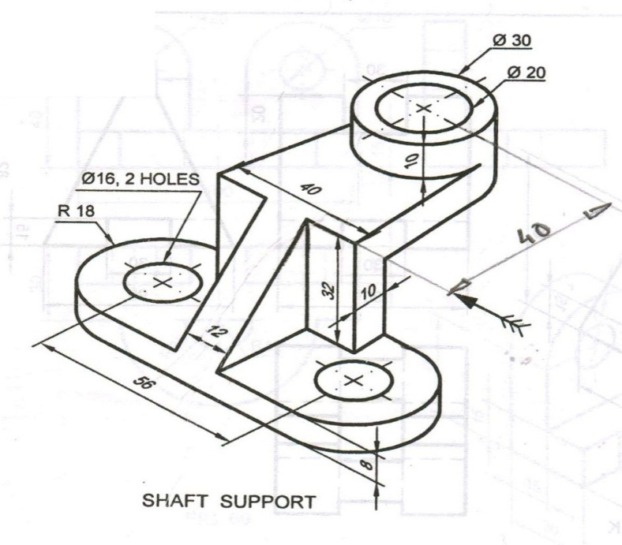
10
10
32
8
R15
56
12
R10
R18
R8

Slide 48

Thank You for Patient Hearing

